Slide 1
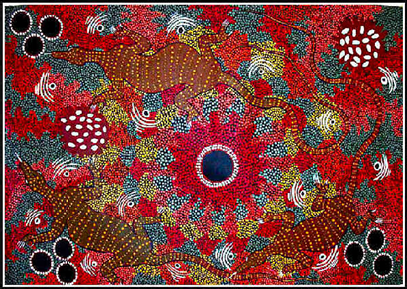
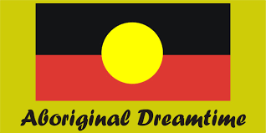
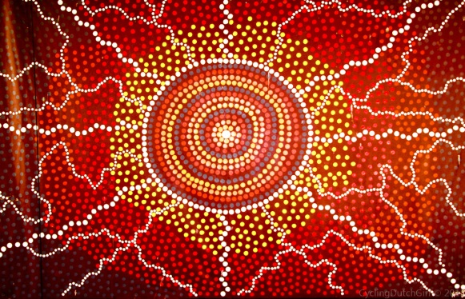
Indigenous Relationships with landscape & Landforms
Year 8 Geography
Aboriginal and Torres Strait Islander

Slide 2
Tropical north queensland traditional owners clip
https://www.youtube.com/watch?v=7CnF2cQeymk
The Indigenous people of Tropical North Queensland
2 minutes
In dot points list the landscapes and landforms you see in the clip
How does the narrator explain togetherness?
How does the narrator show thanks?

Slide 3
Relationship of Aboriginal and Torres strait islander people with landforms
What is Dreaming?
Dreaming is the creation era which extends from the past and in the future.
Aboriginal people have their own explanations of how landforms and landscapes were created.
Aboriginal people believe that everything is created by Dreaming.
The land is sacred to Aboriginal people.
Dreaming stories are central to sacred Aboriginal beliefs.

Slide 4
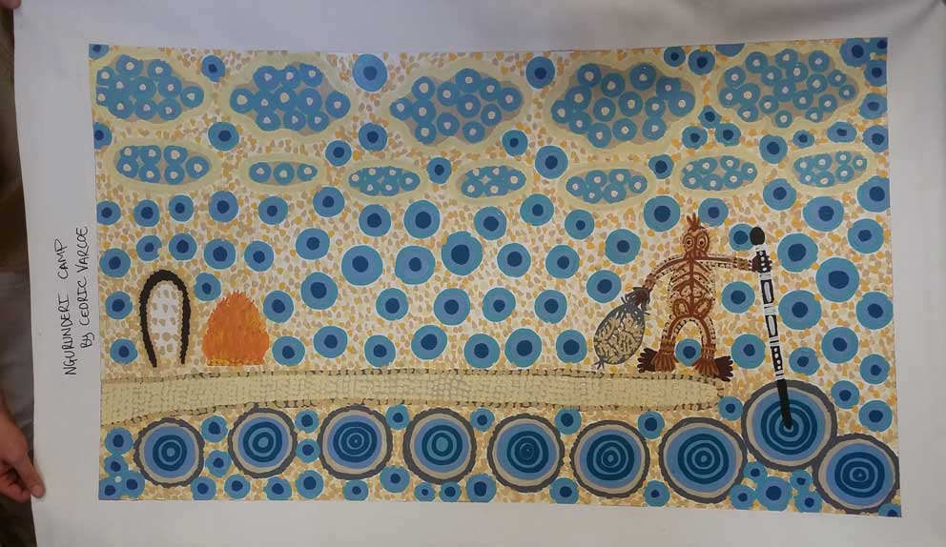
dreamtime stories and legends
Aboriginal and Torres strait islander
For example – the Dreaming story of Ngurunderi which is the traditional Dreamtime story of the origin of the part of the Murray River in South Australia.
p. 103 Pearson

Slide 5
Activity
Read pages 102-103 in your textbook.
Write a paragraph explaining what the Dreaming is and its role in Aboriginal and Torres Strait Islander culture.

Slide 6
The Land owns us clip global oneness project
The Land Owns Us: Uncle Bob Randall
https://www.youtube.com/watch?v=w0sWIVR1hXw
6 minutes

